Slide 2
What makes a good CD8+ T-cell response?
Sarah Rowland-Jones
University of Oxford, UK
@sarahlrj

Slide 3
No conflicts of interest to declare

Slide 4
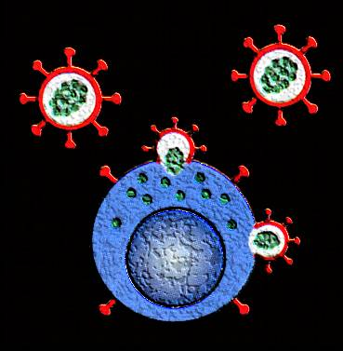
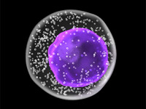
Virus-specific cytotoxic T-lymphocytes (CTL) clear infected cells
CD8+ cytotoxic T-lymphocytes (CTL) identify cells expressing foreign material (from pathogens or tumours), processed as small fragments of protein (8-11 amino acids in length), presented on the surface of the infected cell by HLA class I molecules
Different HLA class I molecules are able to present peptides with different characteristics: a set of three distinct HLA class I molecules (A, B & C) is inherited from each parent
These proteins can come from any part of a pathogen, so include the more conserved structural and functional internal proteins (whereas antibody recognition is largely limited to surface proteins)
Recognition triggers the release of soluble anti-viral factors and the death of the infected cell
Cytokines – soluble anti-viral factors
CC- chemokines
(compete with HIV for
the receptor CCR5)
Cytotoxic factors
– kill the cell

Slide 5
What makes a good virus-specific CTL response?
Acute infections, such as Influenza A (IAV)
  CTL responses target conserved internal proteins, less affected by genetic drift or reassortment, lyse infected cells McMichael Nature 1977
  Magnitude of pre-existing IAV-specific response inversely correlates with duration of symptoms in experimental human infection McMichael NEJM 1983
  Magnitude of pre-existing IAV-nucleoprotein specific CTL response correlates with reduced symptoms in natural seasonal influenza infection Hayward AJRCCM 2015
  Pre-existing CTL against conserved epitopes provide cross-protection against pandemic (H1N1) and avian (H5N1) ’flu Lee, JCI, 2008 Sridhar, Nature Medicine 2013
Chronic infections, such as Cytomegalovirus (CMV)
  CTL responses control viral replication in immunocompetent people, but do not prevent re-infection
  Millenia of co-evolution of virus and host, multiple viral immune evasion mechanisms
  Modest immunosuppression (e.g. pregnancy) allows asymptomatic viral reactivation
  Major immunosuppression (e.g. post transplant, HIV infection) leads to colitis, pneumonitis, retinitis etc.
  Reactivation post-transplant can be controlled with CTL infusion: efficacy depends on development of corresponding CD4+ T-cell responses Walter, NEJM, 1995

Slide 6
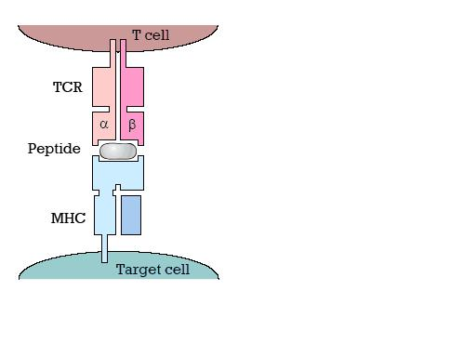
Cytotoxic T Lymphocytes control HIV-1 replication
CD8+ CTL appear very early following HIV-1 infection as VL falls: kill infected cells, suppress viral replication
Inverse correlation between viral load and CTL (tetramer staining), but no relationship between ELISpot responses to HIV peptidome and clinical parameters
Certain HLA class I types (HLA-B27, B57, B81)
are consistently associated with:
  low viral set-point
  delayed progression to AIDS
CD8+ T-cell depletion in SIV-infected macaques
  ⇧ viraemia
  ⇩ CD4 counts
CTL drive HIV-1 evolution through escape mutations
  Interfere with antigen processing/binding to HLA
  ⇩ interaction with TCR
  Leads to HLA-associated “foot-prints” on the virus
HIV-1 has multiple mechanisms to interfere with CTL killing
  Nef down-regulates HLA class I A & B
  Vpu down-regulates HLA class I C
  Nef also up-regulates Fas on cell-surface (CTL killing)

Slide 7
Appreciation of the role of HIV-specific CTL in HIV immunity over the decades
STEP HIV vaccine trial:
CTL-inducing vaccine gives no protection (and may increase susceptibility…)
CTL able to select HIV-1 escape variants
Appear early in acute HIV-1 infection, coincide with VL fall from peak viraemia
Tetramers show inverse relationship between CTL numbers and plasma viral load BUT no relationship between ELISpot responses to HIV proteome and clinical parameters
CTL responses in blood/cervix of highly exposed uninfected subjects
Strong HLA class I associations with HIV outcome, heterozygote advantage
Viral escape correlates with clinical decline
SIV studies show CTL control in acute and chronic infection
HIV-1 adaptation to host HLA seen at population level
HIV genes (nef, vpu) able to downregulate HLA class I, manipulate Fas/FasL expression
HIV-1 CTL show functional impairment, upregulation of inhibitory receptors, exhaustion
bnAbs are so much cooler….
CTL inhibit HIV-1 replication in vitro
First CTL protein targets and peptide epitopes mapped
Late 1980s
1990s
2000s
2010s

Slide 8

The death of T-cell vaccines? The STEP trial
Phase IIb study of recombinant replication defective adenovirus 5 vaccines expressing HIV-1 clade B gag, pol, nef genes (Merck)
Encouraging monkey data, most immunogenic construct in humans tested so far
Halted in Sept 2007 after interim analysis showed no protection, and possible increased risk in vaccinees with high titres of adenovirus 5 antibodies
Subsequent analysis showed modest CD8+ T-cell responses (163 – 686/10⁶ sfu by ELISPOT) in 77% of participants, limited breadth, lower responses in people with high titre adenovirus antibodies McElrath, Lancet, 2008
Was this a failure of the entire concept of T-cell vaccines or just this product?

Slide 9
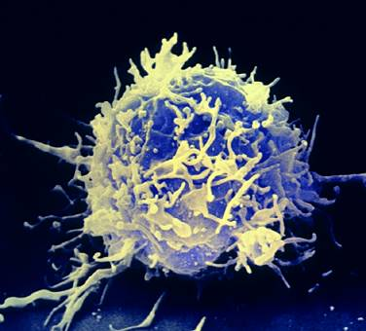
What measures can we use to assess the “quality” of the CD8+ T-cell response ?
Production of antiviral cytokines and chemokines
  CTL from LTNPs are more polyfunctional Betts, Blood 2006
Ability to suppress HIV replication
  Potent suppression by CTL from Elite Controllers Saez-Cirion, PNAS 2007
  In vitro suppression assays do not always correlate with conventional T-cell assays (cytolysis, IFNγ secretion) Chen JVI 2009
Cytolytic ability (perforin content)
  CTL from LTNPs proliferate better and have higher perforin content Migueles, Nature Imm. 2002
“Maturity” and differentiation state
  HIV-1-specific T-cells are at an unusual intermediate stage of differentiation (CD27+CD28-) Appay, JEM 2000, Nature Med. 2002
Expression of inhibitory receptors – PD-1, TIGIT, CTLA-4 – “exhaustion”
Affinity of responding T-cells - are high affinity cells more effective killers? Almeida, JEM 2007, Blood 2009, Ladell, Immunity 2013
Diversity of responding T-cells - TcR usage, clonality Dong, JEM, 2004, Chen, Nature Imm. 2012
Specificity and breadth of response
  ability to contain escape mutation Kelleher, JEM 2001
Ability to proliferate and resist apoptosis
Transcriptional profile and metabolic state

Slide 10
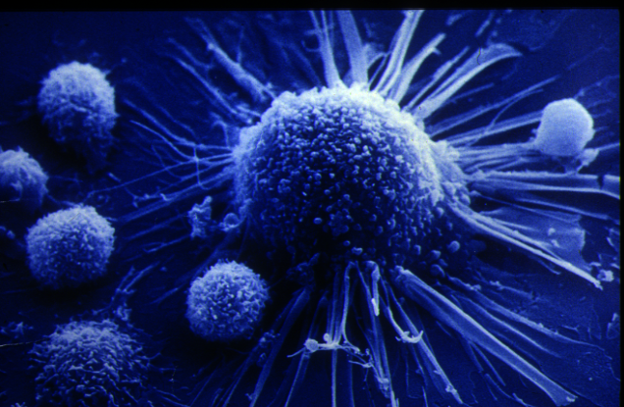
Features of the HIV-1-specific CTL response associated with viral control
LTNPs are not distinguished from progressors on the basis of magnitude or breadth of CTL responses
Production of anti-viral cytokines and chemokines by HIV-specific CD8+ T-cells broadly similar between progressors and non-progressors Appay, JEM 2000
Presence of CTL responses to > 3 epitopes in gag correlates with lower viral load Kiepiela, Nat. Med. 2007
CTL from LTNPs more likely to be polyfunctional and produce MIP-1β Betts, Blood, 2006
HIV-specific CTL from LTNPs better able to proliferate and show higher levels of Perforin and Granzyme B Migueles, Nat. Imm. 2002, Immunity 2008
CTL from LTNPs likely to be of high avidity Almeida, JEM 2007, Blood 2009
More potent suppression of viral replication by EC CTL Saez-Cirion, PNAS 2007
Progressors more likely to have CTL expressing markers of senescence (CD57) or exhaustion (PD-1) Brenchley, Blood 2002, Day, Nature 2007
Certain T-cell receptors may convey an advantage e.g. the ability to contain escape mutation Dong JEM 2004, Ladell, Immunity, 2013 or unusually high avidity
Targetting of conserved or highly “networked” epitopes Gaiha, Science 2019
cART in hyperacute HIV infection leads to robust HIV-specific CD8+ T-cells with superior functional properties Ndhlovu, Science TM, 2019

Slide 11
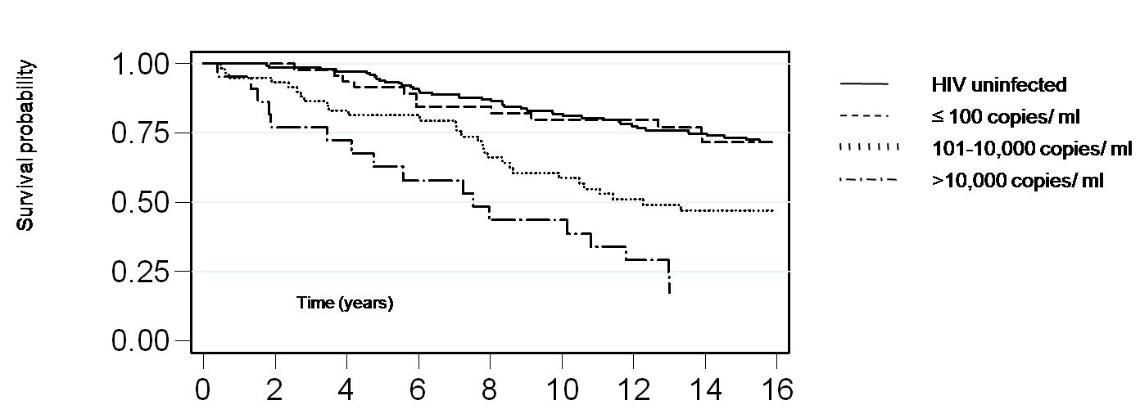
T-cell control of a pathogenic lentivirus: the example of HIV-2
HIV-2 progression is significantly slower than HIV-1, but majority of infected people will eventually progress to disease without cART Esbjornsson et al, Lancet HIV, 2018
Subset of HIV-2-infected people are controllers (37% in the Caió cohort) who maintain pVL below detection for >10-15 years and have a normal life expectancy: equivalent to “functional cure”? Schim van der Loeff, Retrovirology 2010
Follow up of 133 HIV-2 infected and 158 HIV-uninfected people in Caio ,1991 – 2006

Slide 12
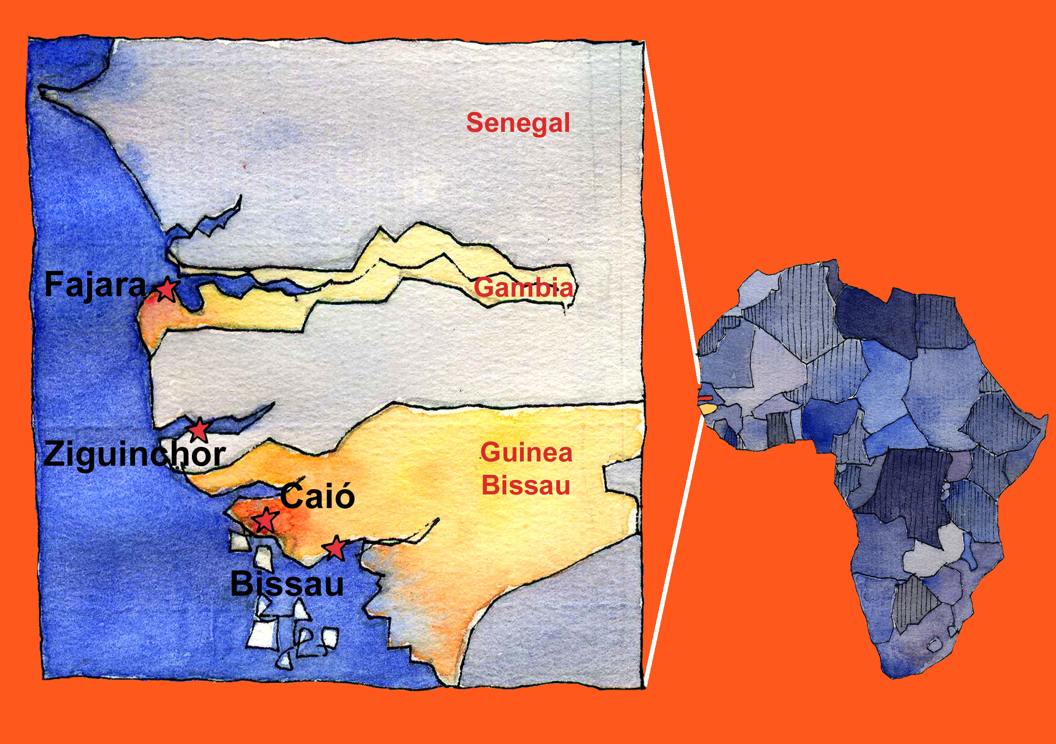
MRC GUM clinic, Fajara:
~3000 HIV-1/-2/dual patients
ART available since 2004
Clinic closed in 2009
MRC Laboratories,
The Gambia
Caio: field station in Casheu region
of Guinea Bissau (ART from 2007)
4000 adults: 7.9% HIV-2+
Community cohort established 1989
Caió field station and community cohort
M. Cotten

Slide 13
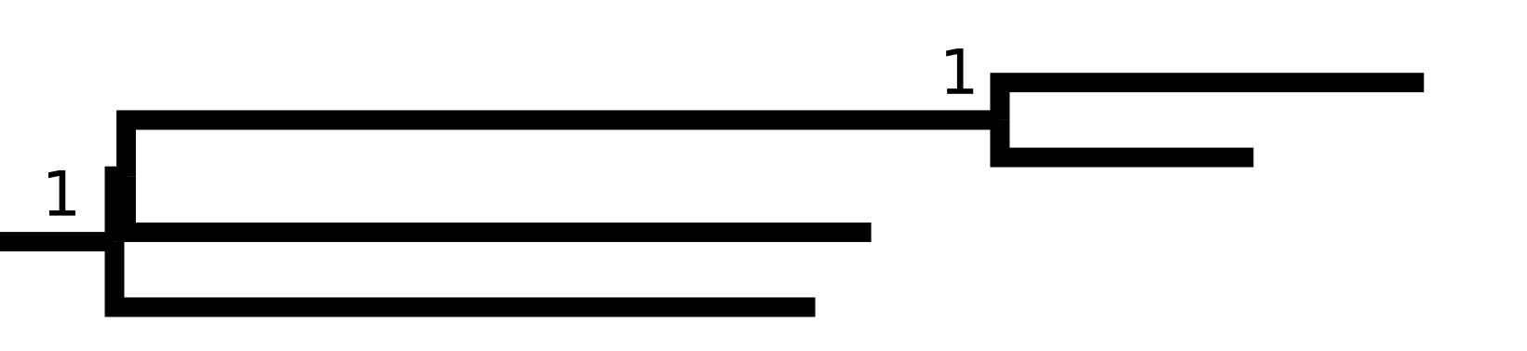




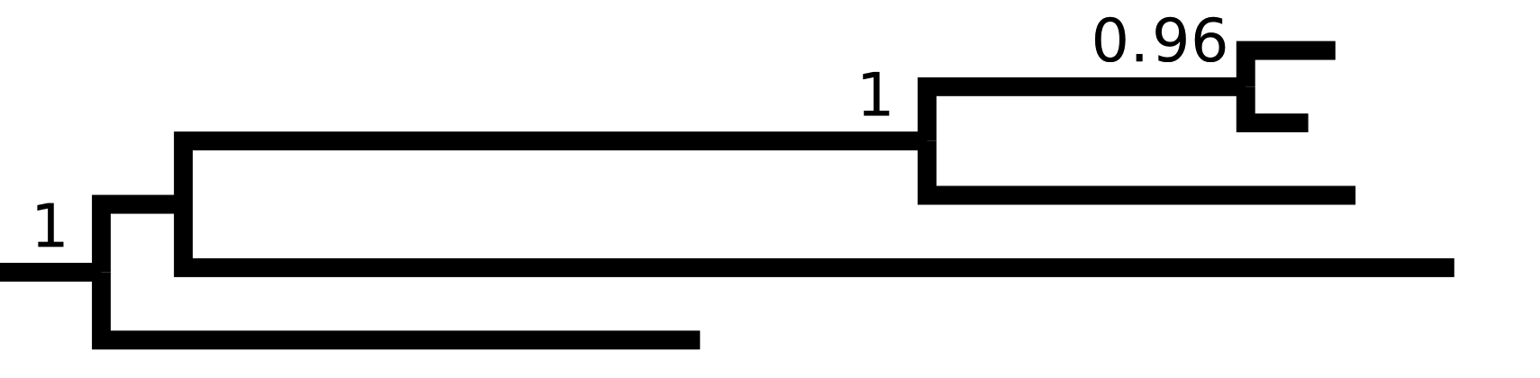
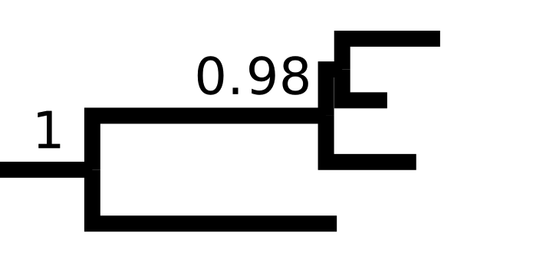



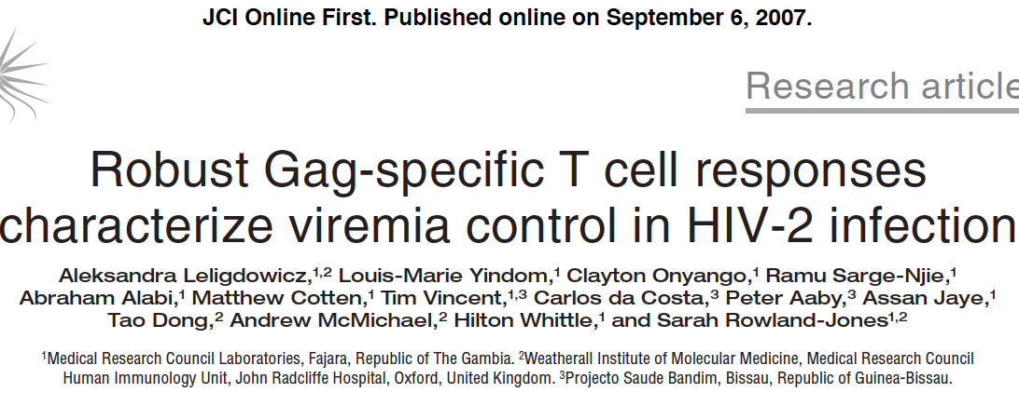
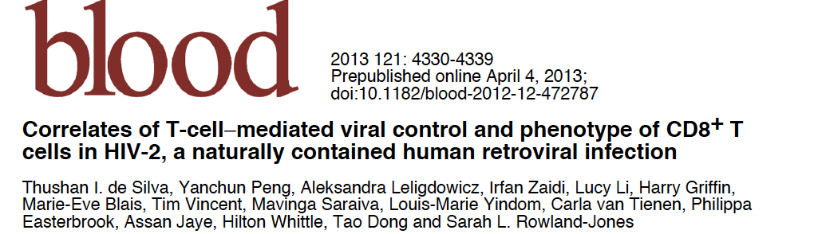
Factors determining HIV-2 outcome: previous data from the Caió cohort
No phylogenetic clustering of virus sequences with progression groups
Very potent bnAb responses which do not correlate with clinical parameters de Silva, JVI, 2010
Controllers have stronger CD8+ T-cell responses than progressors, directed predominantly towards gag Leligdowicz, JCI 2007
Gag-specific populations are uncommon in viraemic subjects (42% vs 84%, p = 0.02)
Bayesian maximum clade credibility trees, showing env (1300bp) and gag (690bp) from Caio cohort
Elite controller
Detectable Viral Load
Known partners within cluster
de Silva, van Tienen, et al, AIDS 2012

Slide 14

HIV-2 control is associated with strong gag-specific CD8+ T-cell responses but not with specific class I HLA alleles
Significantly stronger CD8+ T-cell responses in HIV-2 controllers compared with progressors Leligdowicz, JCI, 2007, de Silva, Blood 2013
CD8+ T-cells in controllers predominantly target the capsid (gag) protein, whereas gag-specific responses are absent in >50% of progressors de Silva, Blood 2013
HIV-2 disease progression is associated with HLA-B*1503, but there are no “protective” HLA class I alleles Yindom, JVI, 2010
CD8 (but not CD4) responses
to pooled gag peptides

Slide 15
Dominant HIV-2 gag-specific CTL clonotypes show broad recognition of viral variants at low antigen concentrations
Donors with the common West African allele HLA-B*3501 respond to gag epitope NY9 with tetramer frequencies up to 1.75% of circulating CD8+ T-cells, showing an inverse correlation with plasma VL
High avidity, dominant CTL clones recognise antigen at picomolar concentrations and show preferential use of TRBV19 Leligdowicz, EJI, 2010, but do not exhibit “public” TCR usage – although there are ”public motifs” (Moysi, ms submitted)
The dominant high avidity clonotypes exhibited broad recognition of peptides representing HIV-1 and HIV-2 variants of the epitope
Viral sequence analysis showed no evidence of CTL driven “escape” mutations (Moysi, ms submitted)

Slide 16
Despite potent gag-specific CD8+ T-cell responses, there is limited evidence for CTL selection of HIV-2 “escape” variants
Comparison of HIV-1 and HIV-2 reference sequences to show amino acid positions under
positive selection in the Caió cohort (shown in red): n = 6 - 12 in HIV-1, n = 2 in HIV-2
HIV-2 selection sites are not within known CTL epitopes (underlined) de Silva AIDS 2018

Slide 17
Preservation of immune potential and anti-viral activity in controllers with HIV-2 infection
Comparison of HIV controllers with HIV-1 or HIV-2 infection (French ANRS cohorts)
HIV-2 control is distinguished by preserved thymic activity (TRECs) and lymphopoietic activity (CD34+ Lin- and CD117-CD45RA+ stem cells, naïve CD4/CD8 T-cells)
HIV-2-specific CD8+ T-cells show earlier differentiation state and exhibit unusually vigorous HIV suppressive activity – more potent than most HIV-1 elite controllers Angin, J. Immunology, 2016
Log p27 decrease in HIV-1 or HIV-2 controllers.
(p27 concentration in supernatant of infected CD4+ T cells alone divided by p27 concentration in supernatant of HIV-infected CD4+ T cells, co-cultured in presence of autologous CD8+ T cells). Bars indicate the median.

Slide 18
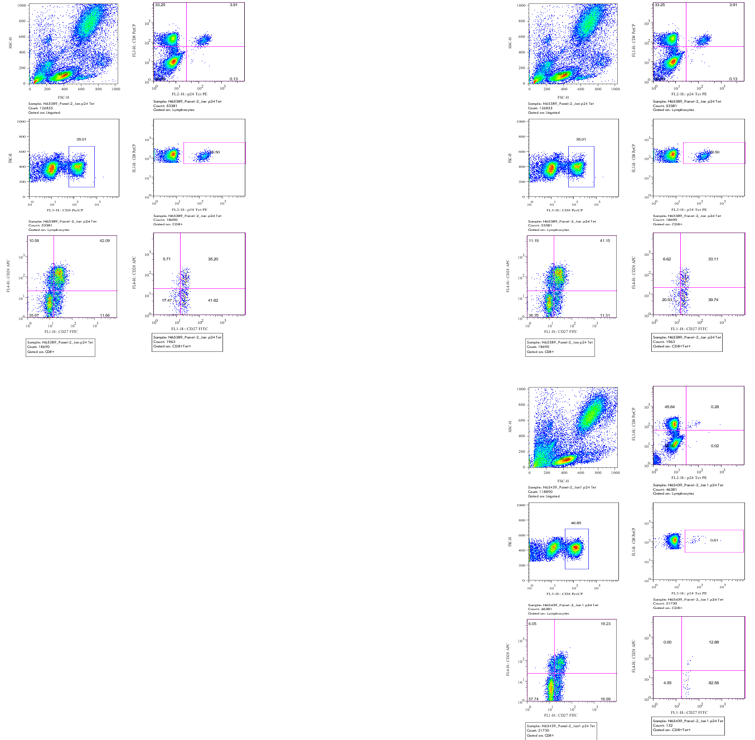
Distinct characteristics of HIV-2-specific CD8+ T-cells associated with viral control
HIV-2-specific CTL are at an earlier stage of differentiation than HIV-1-specific CTL – better able to proliferate Leligdowicz, EJI 2010, de Silva, Blood, 2013
Persist at very high frequencies (up to 10% of all CD8+ T-cells) despite undetectable plasma viral load: how? - mechanism unknown
Target highly conserved regions of gag, including MHR (Leligdowicz, JCI 1997), often cross-reactive with HIV-1 epitopes, do not appear to select escape variants de Silva, AIDS, 2018
Some clonotypes show unusually high avidity: produce high levels of anti-viral cytokines at very low (picomolar) antigen concentrations Leligdowicz, EJI 2010, de Silva, Blood 2013, Moysi ms submitted
Unlike HIV-1+ ECs, CTL from HIV-2+ ECs do not have higher Perforin or T bet levels than progressor CTL de Silva, Blood 2013 but do contain high levels of Granzyme B Angin, JI 2016
CTL from HIV-2 ECs show potent suppression of HIV-2 replication in vitro Angin, JI 2016

Slide 19
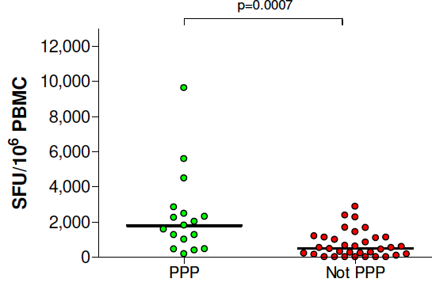
A link between the HIV-2 p26 sequence motif of non-progressors and antigen processing
Although there is no overall phylogenetic association between viral gag sequences and outcome, a motif of 3 proline residues (“PPP”) across the HIV-2 capsid is strongly associated with low viral load Onyango, Vaccine, 2010
The first Proline is linked to increased TRIM5a susceptibility Song, JVI, 2007
T-cell responses to p26 peptides (but not to other antigens) are increased in subjects infected with HIV-2 containing the “PPP” gag motif
The other two of these Prolines lie in the flanking region of the “protective” HLA-B14-restricted DA9 peptide epitope, strongly associated with low viral load Leligdowicz, JCI 2007
Long peptides containing the HIV-2 PPP sequence are more efficiently digested in vitro by isolated proteasome preparations to the peptide 46 epitope Jallow, EJI, 2015

Slide 20
Hypothesis: TRIM5a-capsid interactions determine generation of potent gag-specific CTL and viral control in HIV-2 infection
Human TRIM5α has limited activity against HIV-1 and SIVmac, but shows greater activity against HIV-2 Ylinen JVI 2005
More potent interactions between TRIM5a SPRY domain and capsid lead to increased Type I IFN production Pertel, Nature 2011
HIV-2 capsid sequences, containing 3 prolines (“PPP”), are associated with low viral load and strong gag-specific CTL, as well as increased TRIM5a susceptibility Onyango, Vaccine, 2010
Long peptides containing the HIV-2 PPP sequence are more efficiently digested by the proteasome to the “protective” peptide 46 (MHR) epitope Jallow, EJI, 2015
Are distinct combinations of polymorphic capsid and TRIM5a associated with potent binding, proteasomal digestion of protective epitopes and priming of protective CTL responses?

Slide 21
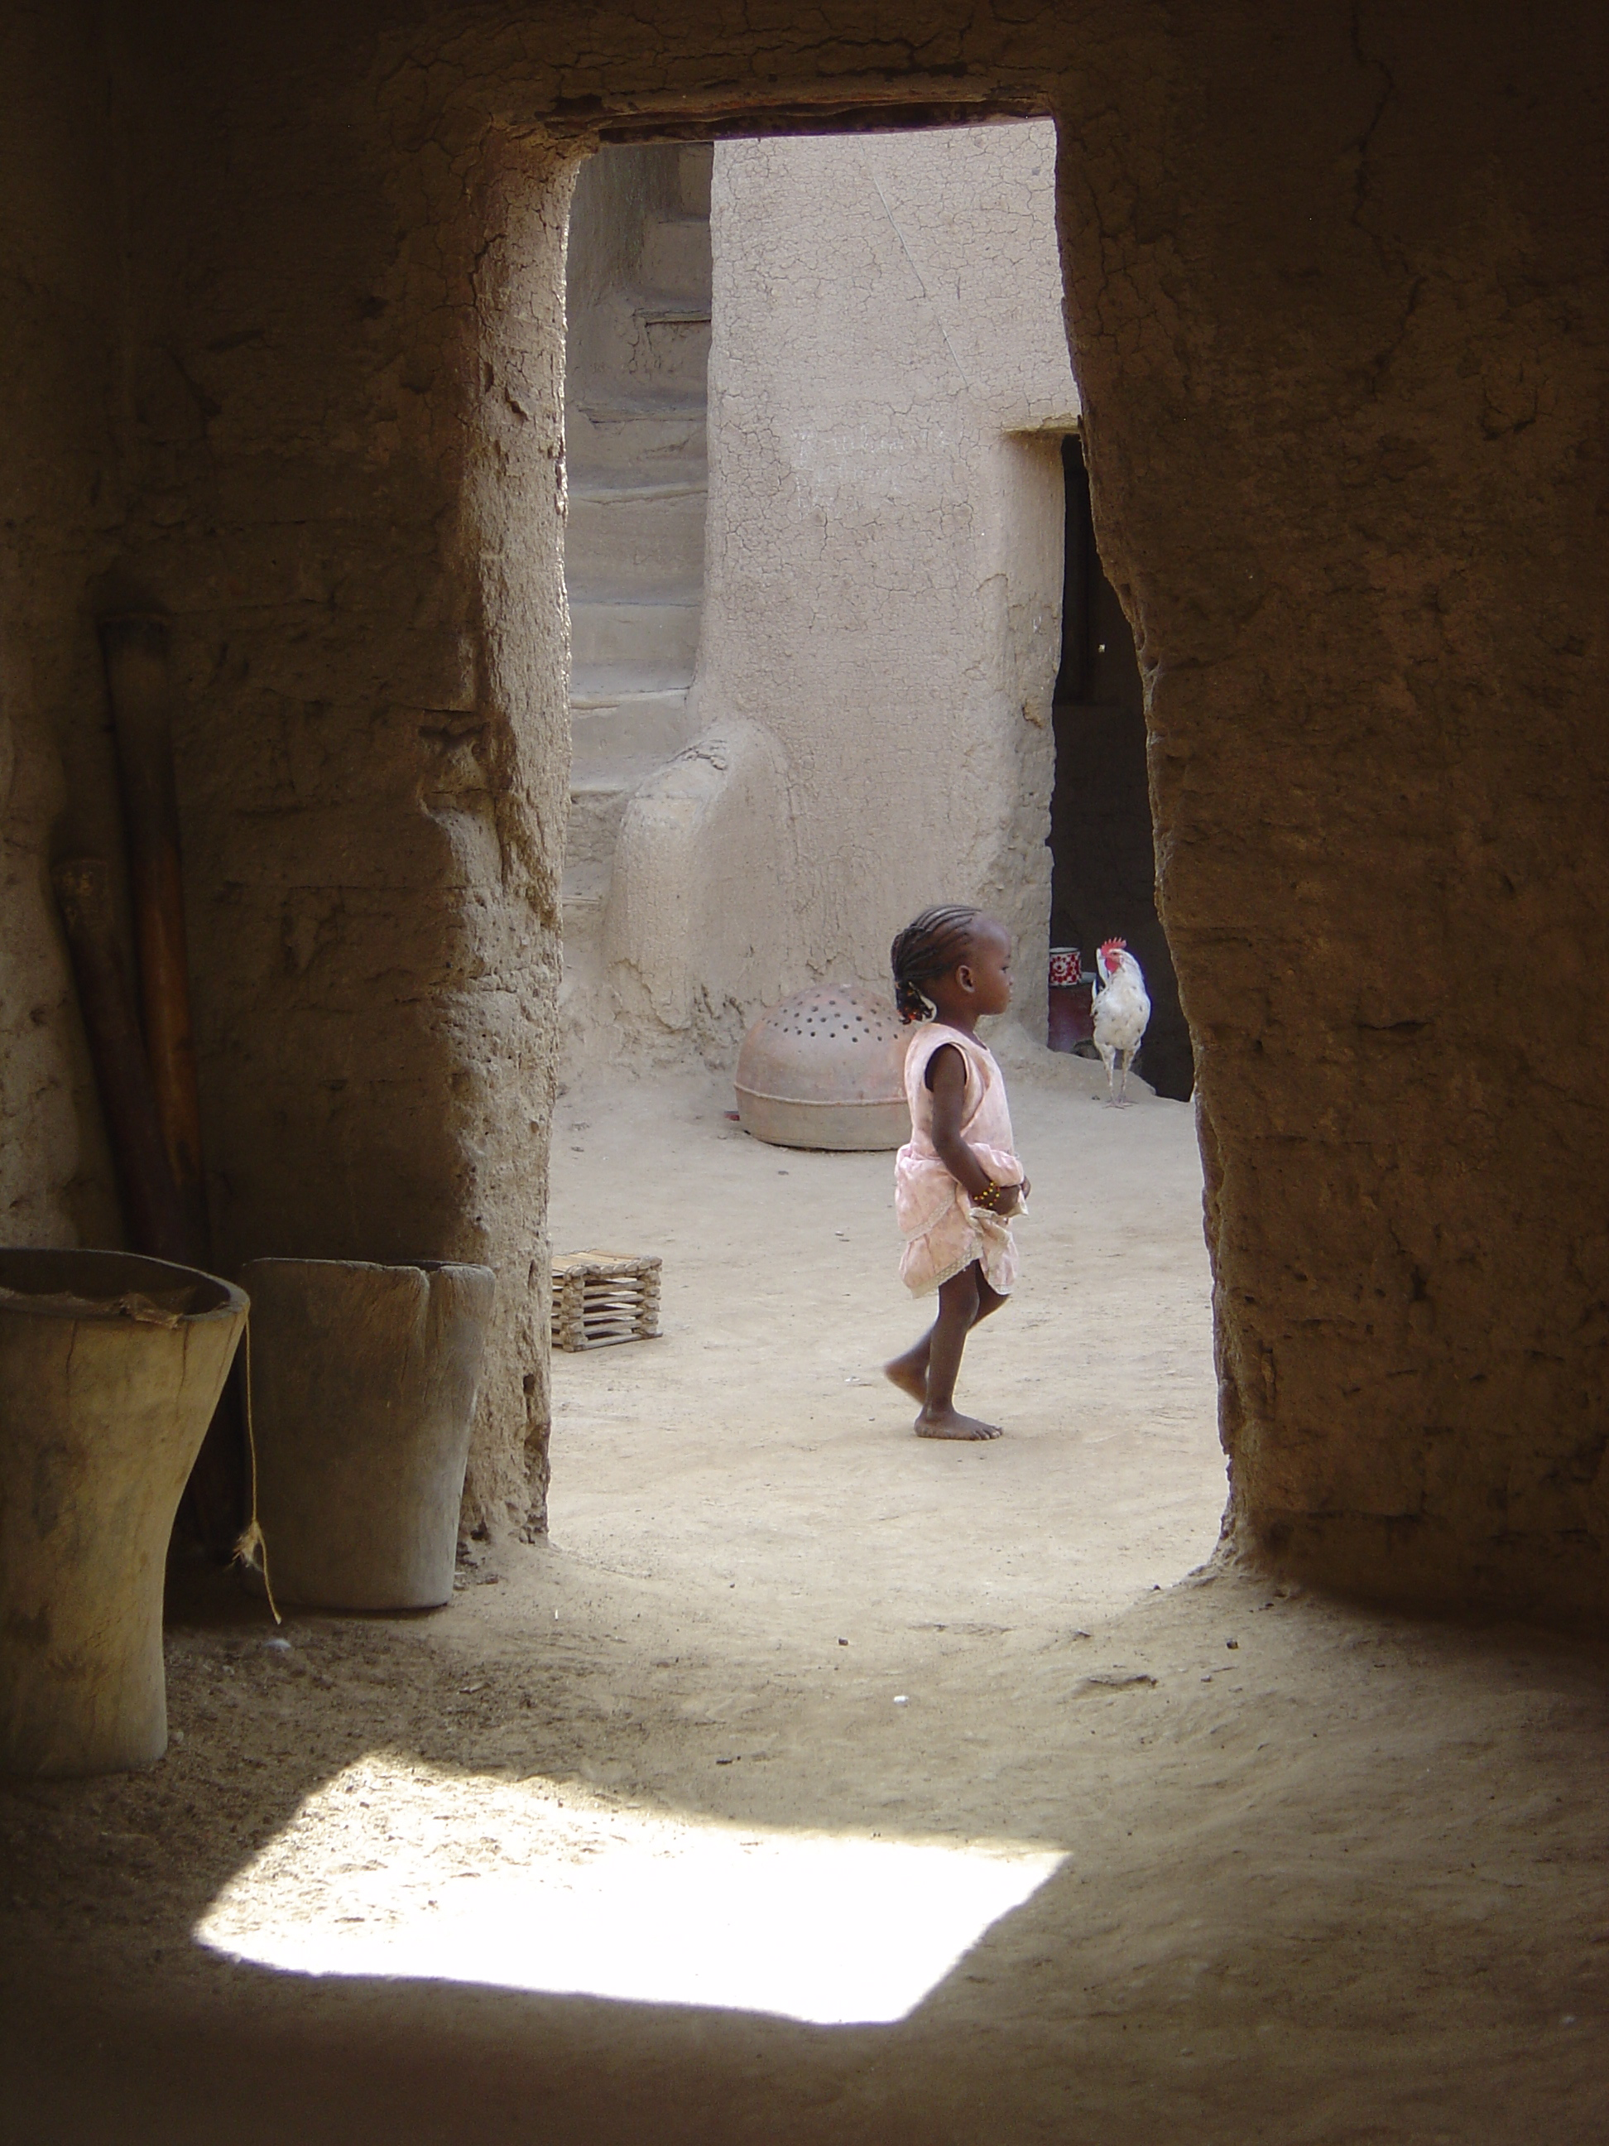
HIV-2 CTL responses: conclusions
HIV-2 provides an important human model of control of a potentially pathogenic retrovirus, potentially equivalent to HIV “functional cure”
“Non-progression” has clear immune correlates: good quality CD4+ T-cell help, high magnitude, early-differentiated CD8+ T-cell responses, but NOT broadly neutralising antibody responses
Control of viraemia is strongly associated with CD8+ T-cell responses to gag, notably a highly conserved (MHR) region in the capsid protein
T-cells responding to this region are polyfunctional, able to proliferate and show unusually high functional avidity
They are maintained at high levels in the absence of detectable plasma virus
They also show potent suppression of HIV-2 replication in vitro, with limited selection of escape variants

Slide 22
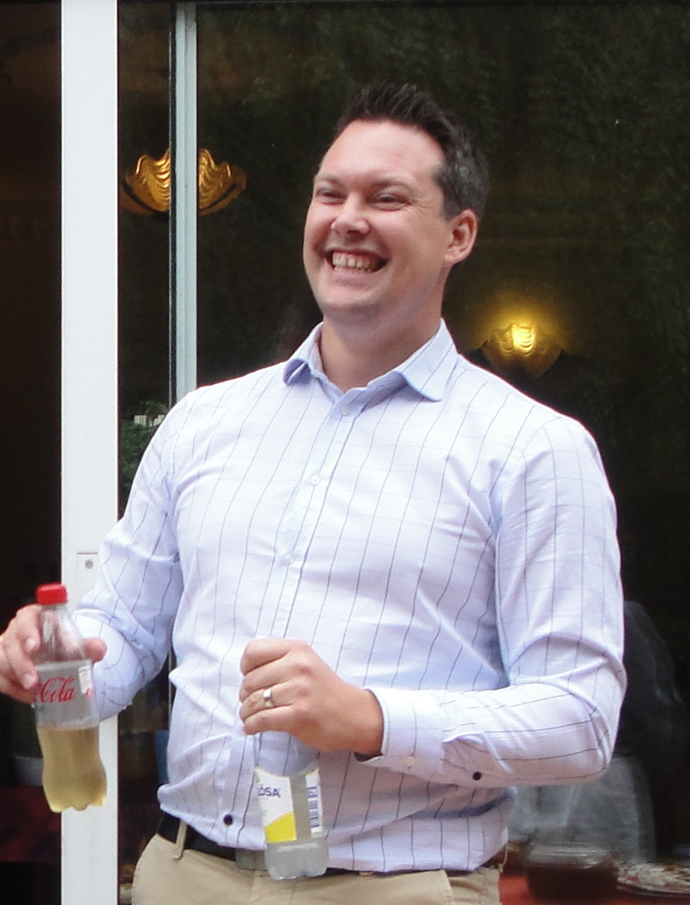
Acknowledgements
Oxford University
  Sophie Andrews
  Glenn Wong
  Kat James
  Shmona Simpson
  Michael Boswell
  Eirini Moysi
  Sabelle Jallow
  Louis-Marie Yindom
Tao Dong
Simon Davis
Benedikt Kessler
Nicola Ternette
Peijun Zhang
William James
University of Hokkaido
Kimiko Kuroki
Kengo Hirao
Toyoyuki Ose
Katsumi Manaeka
MRC Labs, The Gambia Pasteur Institute,Paris
  Aleks Leligdowicz Mathieu Angin
  Louis-Marie Yindom Asier Saez-Cirion
  Matt Cotten
  Thushan de Silva
  Clayton Onyango Hôpital Pitié-Salpêtrière, Paris
  Hilton Whittle Victor Appay
  Marianne van der Sande Laura Papagno
  Steve Kaye
  Samuel Nyamweya
  Tim Vincent
  Akram Zaman
  Hilton Whittle
Aleks Leligdowicz
Thushan de Silva
University of Lund
Joakim Esbjornsson
Patrik Medstrand
Microsoft Research
Jonathan Carlson

